Slide 1
Introduction to Neural Network

Slide 2
Elements of a Neural Network
Input Layer :- This layer accepts input features. It provides information from the outside world to the network, no computation is performed at this layer, nodes here just pass on the information(features) to the hidden layer.
Hidden Layer :- Nodes of this layer are not exposed to the outer world, they are the part of the abstraction provided by any neural network. Hidden layer performs all sort of computation on the features entered through the input layer and transfer the result to the output layer.
Output Layer :- This layer bring up the information learned by the network to the outer world.

Slide 3
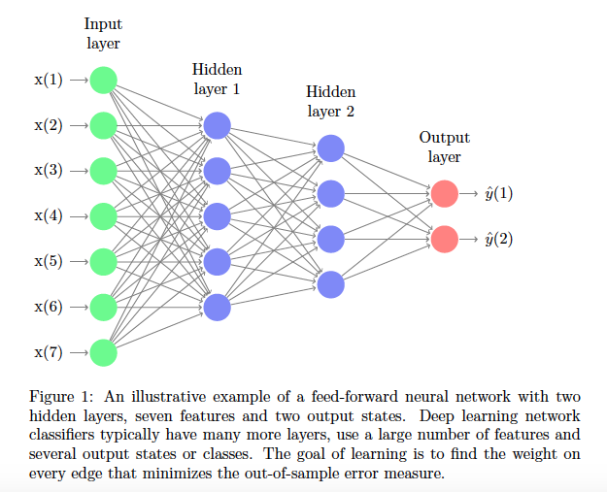
Typical Feed Forward NN

Slide 4
What is an activation function and why to use them?
Definition :- Activation function decides, whether a neuron should be activated or not by calculating weighted sum and further adding bias with it. The purpose of the activation function is to introduce non-linearity into the output of a neuron.
Explanation :- We know, neural network has neurons that work in correspondence of weight, bias and their respective activation function. In a neural network, we would update the weights and biases of the neurons on the basis of the error at the output. This process is known as back-propagation. Activation functions make the back-propagation possible since the gradients are supplied along with the error to update the weights and biases.

Slide 5
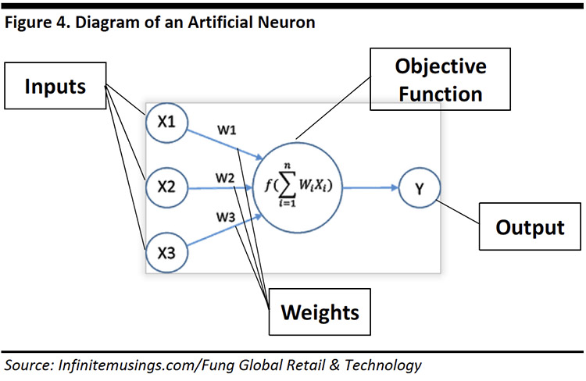
Typical Artificial Neuron

Slide 6
Why do we need Non-linear activation functions :- A neural network without an activation function is essentially just a linear regression model. The activation function does the non-linear transformation to the input making it capable to learn and perform more complex tasks.

Slide 7
Softmax Activation function
Softmax function calculates the probabilities distribution of the event over ‘n’ different events. In general way of saying, this function will calculate the probabilities of each target class over all possible target classes. Later the calculated probabilities will be helpful for determining the target class for the given inputs.

Slide 8
The main advantage of using Softmax is the output probabilities range. The range will 0 to 1, and the sum of all the probabilities will be equal to one. If the softmax function used for multi-classification model it returns the probabilities of each class and the target class will have the high probability.
The formula computes the exponential (e-power) of the given input value and the sum of exponential valuesof all the values in the inputs. Then the ratio of the exponential of the input value and the sum of exponential values is the output of the softmax function.

Slide 9
Properties of Softmax Function
Below are the few properties of softmax function.
The calculated probabilities will be in the range of 0 to 1.
The sum of all the probabilities is equals to 1.
Softmax Function Usage
Used in multiple classification logistic regression model.
In building neural networks softmax functions used in different layer level.

